Slide 1
PILA LED

Slide 2
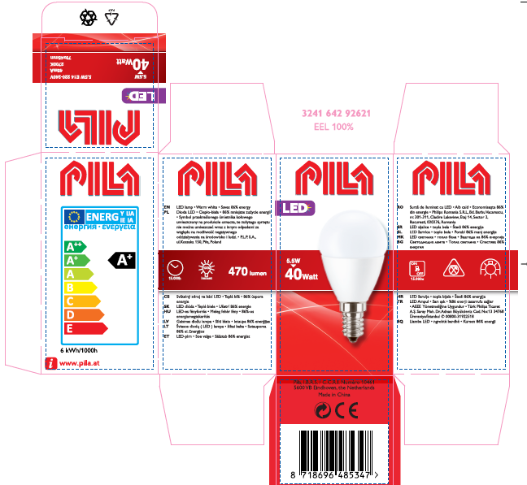
Why PILA LED?
TRADITION
Brand with long tradition – over 30 years on the market
Brand recognized by customers
BASIC PORTFOLIO
Good value for money
LED replacement of the most popular traditional bulb types / shapes
NEW PACKAGING DESIGN
Clear communication on the packaging, easy to understand light parameters on the box
QUALITY
Long lifetime: 15 000 hours (15 years)
Up to 85% energy saving
Warm white light

Slide 3
PILA LED- benefits
XXI century bulbs
LED technology in familiar shape: replacements of the most popular traditional shapes available: bulbs, candles, lustres, spots
Up to 85% energy saving
Investment pays off already within 8 months*
15 years of lifetime
healthy light
100% compliant with EU regulations (DIM2)
warm white light
excellent for general lighting purposes
no heat generated
modern design
* Average working time: 4 hrs/day

Slide 4
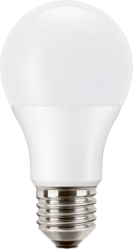
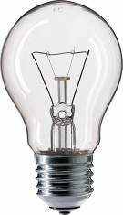
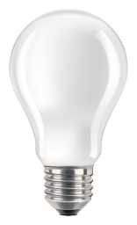
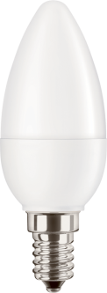
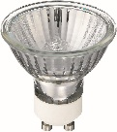
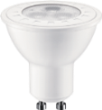
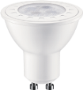
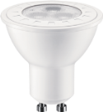
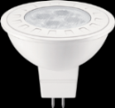
PILA LED available portfolio
40W
60W
75W
100W
25W
40W
40W DIM
40W
35W WW 36D
50W WW 36D
50W CW 60D
65W WW 36D
65W CW 36D
35W WW 12V 36D

Slide 5
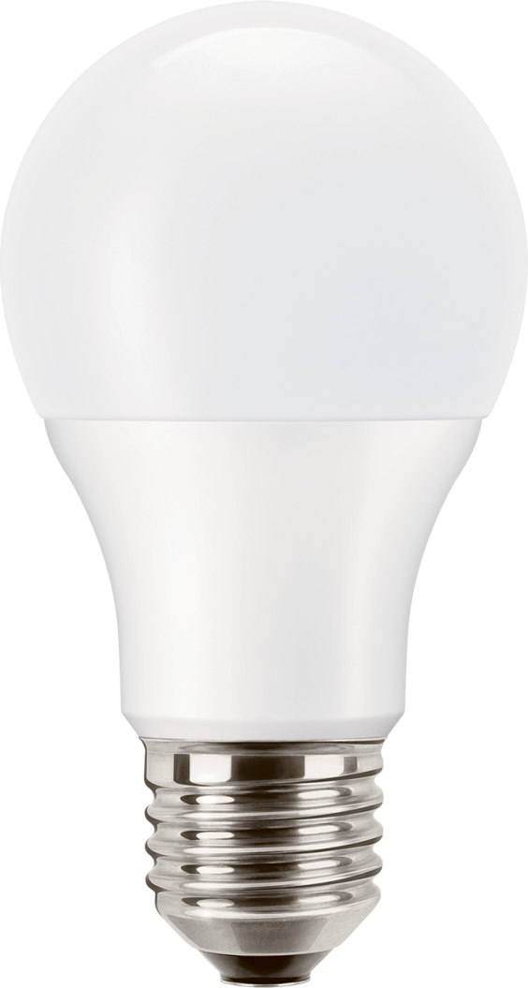
LED bulb- PILA LED 40W E27 WW A60 ND
Description | PILA LED 40W E27 A60 ND
EAN | 8718696485361
Size (mm) | 60x112
Wattage (W) | 5.5
GLS equivalent (W) | 40
Cap | E27
Lum. flux (lm) | 470
CCT (K) | 2700
CRI (Ra) | 80
Lifetime (hrs) | 15 000
Switching cycles | 15000
Dimmable | no
Certification | CE
15 years lifetime
Up to 85% energy saving
Instant start

Slide 6
LED bulb- PILA LED 60W E27 WW A60 ND
Description | PILA LED 60W E27 A60 ND
EAN | 8718696485385
Size (mm) | 60x112
Wattage (W) | 9.5
GLS equivalent (W) | 60
Cap | E27
Lum. flux(lm) | 806
CCT (K) | 2700
CRI (Ra) | 80
Lifetime (hrs) | 15 000
Switching cycles | 15000
Dimmable | no
Certification | CE
15 years lifetime
Up to 85% energy saving
Instant start

Slide 7
LED bulb - PILA LED 75W and 100W E27 WW
15 years lifetime
Up to 85% energy saving
Instant start
Description | EAN | GLS equiv. | Wattage | Flux | CCT | Dimmable | CRI
PILA LED 75W E27 WW A60 FR ND | 8718696526910 | 75W | 12W | 1055 lm | 2700K | no | 80
PILA LED 100W E27 WW A67 FR ND | 8718696526934 | 100W | 15,5W | 1521 lm | 2700K | no | 80

Slide 8
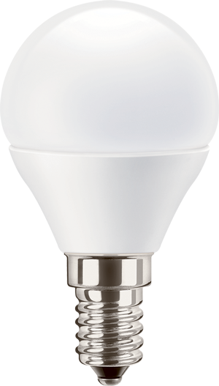
LED lustre - PILA LED 40W E14 WW P45 FR ND
Description | PILA LED 40W E14 WW P45 FR ND
EAN | 8718696485347
Size (mm) | 45x79
Wattage (W) | 5.5
GLS equivalent (W) | 40
Cap | E14
Lum. flux(lm) | 470
CCT (K) | 2700K
CRI (Ra) | 80
Lifetime (hrs) | 15 000
Switching cycles | 15000
Dimmable | no
Certification | CE
15 years lifetime
Up to 85% energy saving
Instant start

Slide 9
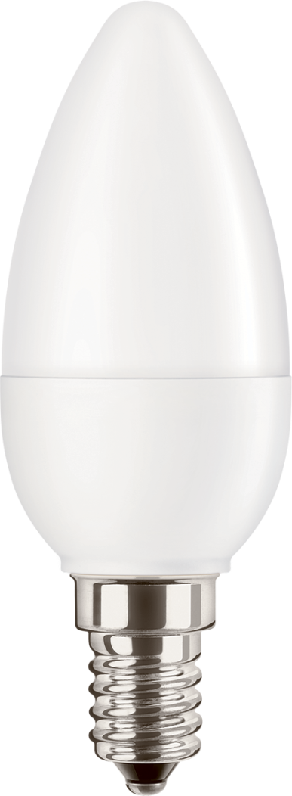
LED candle - PILA LED 25W E14 WW B35 FR ND
Description | PILA LED 25W E14 B35 FR ND
EAN | 8718696485248
Size (mm) | 36x97
Wattage (W) | 3.2
GLS equivalent (W) | 25
Cap | E14
Lum. flux(lm) | 250
CCT (K) | 2700K
CRI (Ra) | 80
Lifetime (hrs) | 15 000
Switching cycles | 15000
Dimmable | no
Certification | CE
15 years lifetime
Up to 85% energy saving
Instant start

Slide 10
LED candle - PILA LED 40W E14 WW B35 FR ND
Description | PILA LED 40W E14 B35 FR ND
EAN | 8718696485262
Size (mm) | 36x103
Wattage (W) | 5.5
GLS equivalent (W) | 40
Cap | E14
Lum. flux(lm) | 470
CCT (K) | 2700K
CRI (Ra) | 80
Lifetime (hrs) | 15 000
Switching cycles | 15000
Dimmable | no
Certification | CE
15 years lifetime
Up to 85% energy saving
Instant start

Slide 11
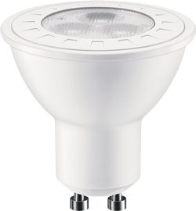
LED reflector GU10 - PILA LED 35W GU10 WW 36D ND
Description | PILA LED 35W GU10 36D ND
EAN | 8718696485187
Size (mm) | 50x55
Wattage (W) | 3.3
GLS equivalent (W) | 35
Cap | GU10
Lum. flux(lm) | 230
CCT (K) | 2700
CRI (Ra) | 80
Lifetime (hrs) | 15 000
Switching cycles | 15000
Dimmable | no
Certification | CE
Directional light
15 years lifetime
Up to 85% energy saving
Instant start

Slide 12
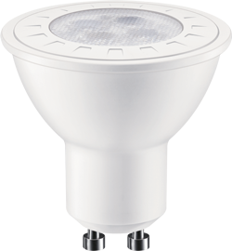
LED reflector GU10 - PILA LED 50W GU10 WW 36D ND
Description | PILA LED 50W GU10 36D ND
EAN | 8718696485200
Size (mm) | 50x55
Wattage (W) | 5.5
GLS equivalent (W) | 50
Cap | GU10
Lum. flux(lm) | 345
CCT (K) | 2700
CRI (Ra) | 80
Lifetime (hrs) | 15 000
Switching cycles | 15000
Dimmable | no
Certification | CE
Directional light
15 years lifetime
Up to 85% energy saving
Instant start

Slide 13
LED reflector GU10 - PILA LED 50W GU10 WW 60D ND –wide beam
Directional light
15 years lifetime
Up to 85% energy saving
Instant start
Coool white light: 4000K
Wide beam angle: 60 degrees
Description | EAN | Wattage | GLS equiv. | CCT | Dimmable | Beam angle | CRI
PILA LED 50W GU10 CW 60D ND | 8718696537015 | 5,5W | 50 | 4000K | No | 60D | 80

Slide 14
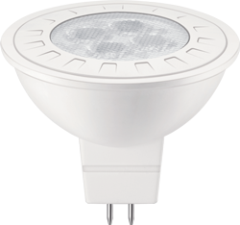
LED reflector GU5.3 - PILA LED 35W GU5.3 WW 12V 36D ND
Description | PILA LED 35W GU5.3 12V 36D ND
EAN | 8718696485163
Size (mm) | 50x47
Wattage (W) | 5.5
GLS equivalent (W) | 35
Cap | GU5.3
Lum. flux(lm) | 345
CCT (K) | 2700
CRI (Ra) | 80
Lifetime (hrs) | 15 000
Switching cycles | 15000
Dimmable | no
Certification | CE
Directional light
15 years lifetime
Up to 85% energy saving
Instant start

Slide 15
Available of January 2016:

Slide 16
LED candle - PILA LED 40W E14 WW B35 FR dimmable
15 years lifetime
Up to 85% energy saving
Dimmable
Instant start
Description | 40W E27 WW B35 FR DIM
12NC | 929001195931
EAN | 8718696534168
GLS equivalent (W) | 40
Cap | E14
Lum. flux(lm) | 470
CCT (K) | 2700K
CRI (Ra) | 80
Lifetime (hrs) | 15 000
Switching cycles | 15000
Dimmable | yes
Certification | CE

Slide 17
Portfolio LED reflektor MV
Directional light
15 years lifetime
Up to 85% energy saving
Instant start
Description | 12nc | EAN | GLS equiv. | CCT | Beam angle | CRI
PILA LED 65W GU10 WW 36D ND | 929001196131 | 8718696534205 | 65W | 2700K | 36D | 80
PILA LED 65W GU10 CW 36D ND | 929001196231 | 8718696534229 | 65W | 4000K | 36D | 80

